Slide 1
TFM DL Tools for Finance Application Transfert Learning Vgg16sp500
I Miled 2019 2020

Slide 2
Objective
The objective of the transposition of deep learning methodology to finance was to focus on:
1. classification of current/future of market/economic state
2. prediction of future price
3. construction of investment strategies
4. risk estimation
5. process news flow to assess market sentiment

Slide 3
Problem of validity of Technical analysis
In any case, for this TFM I will focus deeper only on one specific problem
Technical Analysis which a methodology for forecasting the direction of prices through the study of past market data, primarily price and volume.
The ground of this theory comes from behavioral economics and quantitative analysis, which stands in contradiction of much of modern portfolio theory and market valuation.

Slide 4
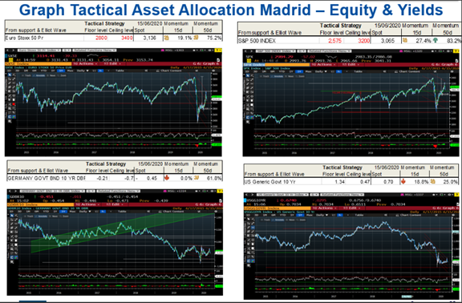

Slide 5
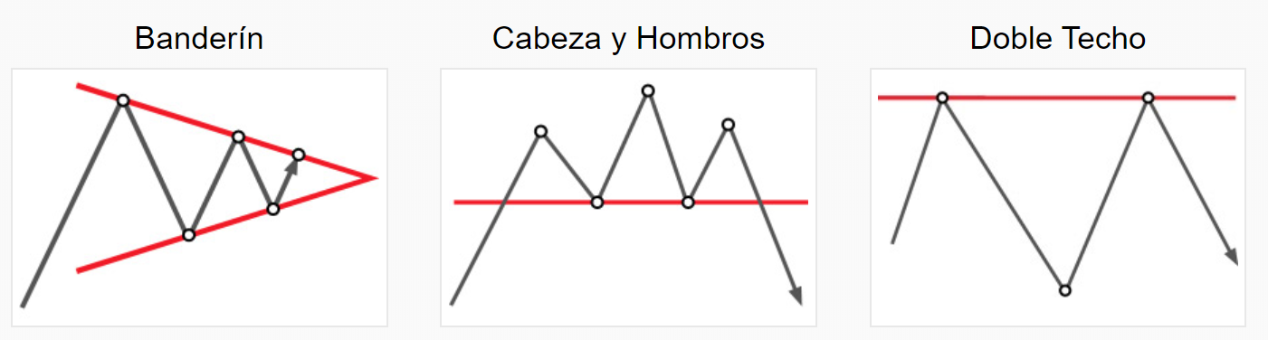
Example of standard figures
su
Source https://www.instaforex.com/sp/techanalysis

Slide 6
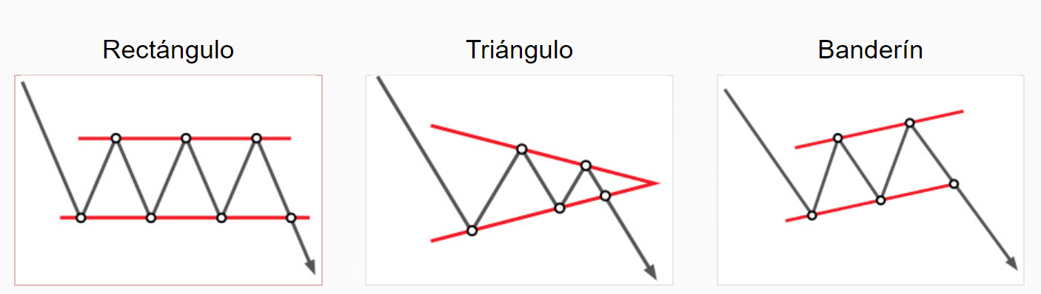
Example of standard figures
su
Source https://www.instaforex.com/sp/techanalysis

Slide 7
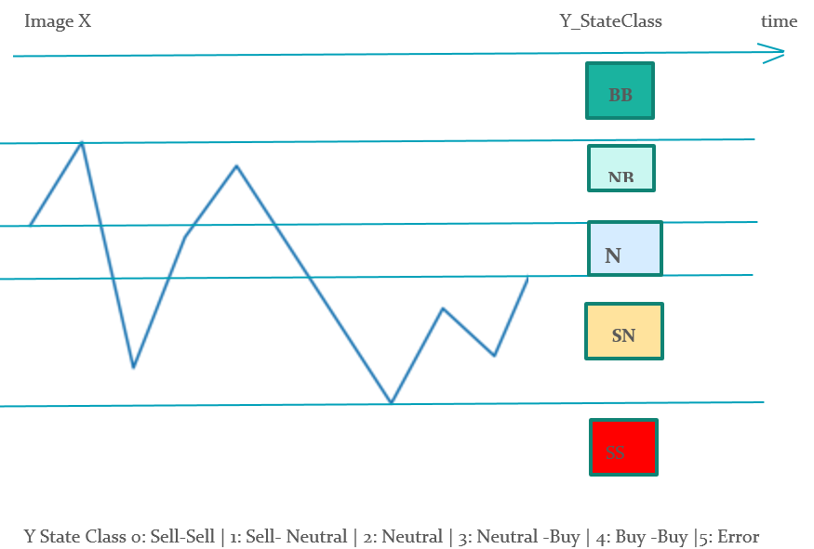
Dataset construction

Slide 8
Choice of datas
Market considerations
Liquidity
History
Number of participants
Reference
Also I selected the American equity index SPX 500 for this project as it is the most liquid equity indices where many operators can interact from retail to institutional investors. Moreover the index has a long history that I see from 1927. Also the index price are quoted every working day.

Slide 9
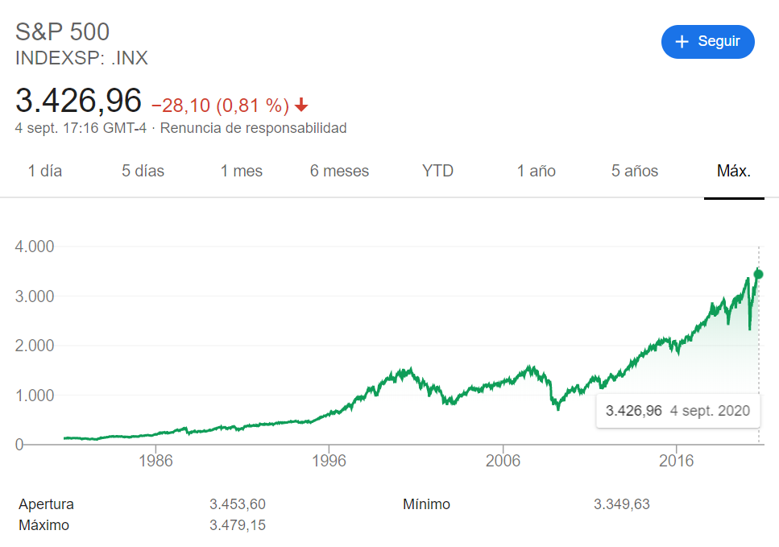
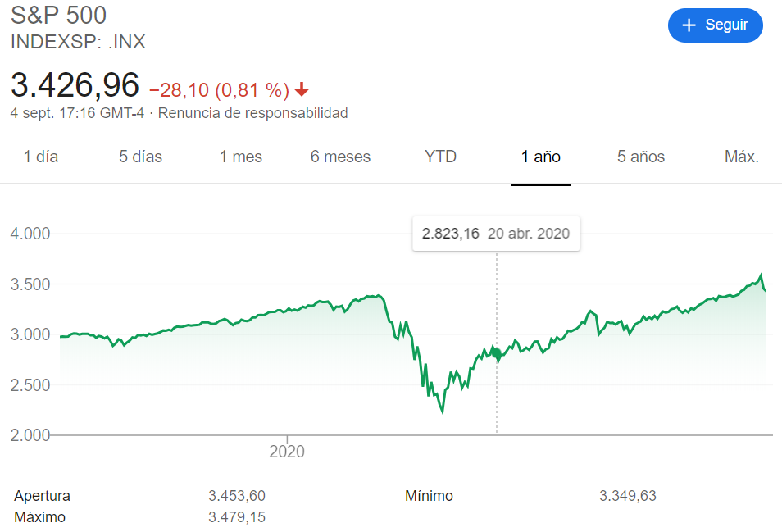
Source google

Slide 10
Dataset Construction
The historical datas are downloaded through yahoo API
I splited the datas in 4 np.array group x_train, x_test and y_train, y_test owith a total of 23254 images and 23254 state
Input history 250 past days of 255 x 255 x1 np array (in grey)
Future state 20 next days for 5 states between 0 and 4
Sell-Sell | Sell- Neutral | Neutral | Neutral -Buy | Buy -Buy
NB: on split on time horizon minute day week month years

Slide 11
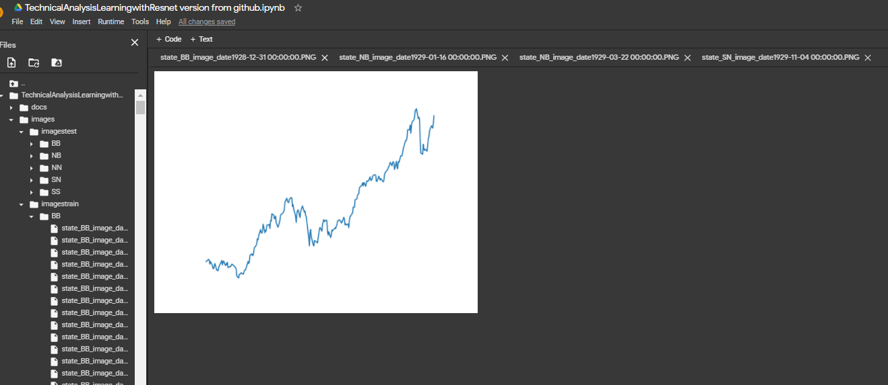
Dataset view

Slide 12
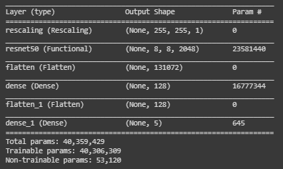
Description of the methodology and tools used
Colab, Tensorflow Keras, Transfert Learning Resnet Vgg and personalized modek
batch_size=[25,50,100]
epochs=[25,50,100]
learning_rate=[0.001,0.01,0.1]
optimizer_name= SGD, RMSprop, Adam
Loss = SparseCategoricalCrossentropy

Slide 13
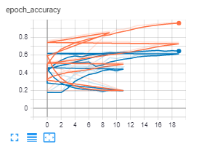
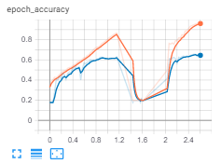
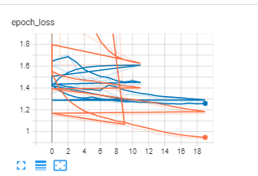
Summary of the current results

Slide 14
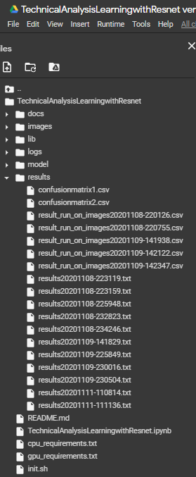
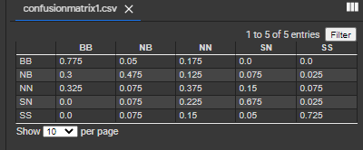
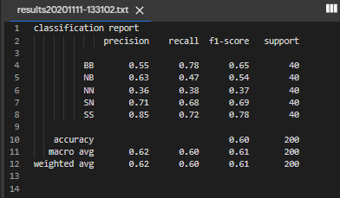
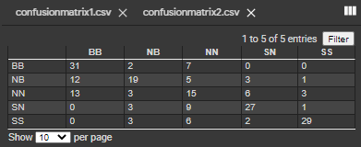
Validation
Results with this trained model are acceptable but can be improved

Slide 15
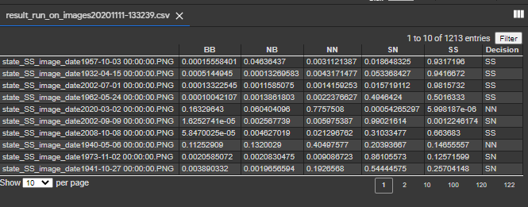
API
Take an image of an historical graph from a market webpage like investing.com, crop the image to only fit the graph and save it to the ImageM/ folder for example with name image1.PNG or give the full path of the image when asked.
This execution tell us which market state in the future is the best representative.
Also we can get the future of all the graphs as an image in a directory and gives us the trading signals for a list of stock very quickly

Slide 16
Conclusion
The results of this study are quite good in terms of accuracy and confidence and can be used as a decision tool for some equity indices
However, we may assume starting from an image interpretation that there is less statistical bias that predict from historical data (momentum, motion process probality) but this need to be proven.
I will now focus on applying the model with different asset classes such as rates or macro datas as it does not follow a time compounded process

